Slide 1
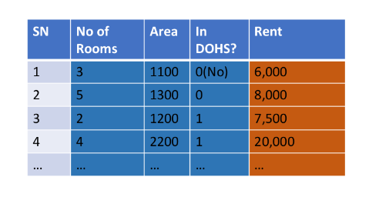
What is ML?

Slide 2


Meet your new best friends

Slide 3
Bringing in a dataset from Kaggle

Slide 4
Bringing in a dataset from Kaggle
Use the code given to you
From your kaggle account generate the api key
Bring in and extract the dataset
The notebook is available here

Slide 5
Steps
Import the data
Clean the data
Split the data into training or test sets
Create a model
Train a model
Make predictions
Evaluate and improve

Slide 6
Steps
Import the data
Clean the data
Split the data into training or test sets
Create a model
Train a model
Make predictions
Evaluate and improve

Slide 7
Pandas

Slide 8
Pandas
Installing Pandas
! pip install pandas
Bringing a spreadsheet under a data frame
import pandas as pd
df = pd.read_csv(‘path to the csv file')

Slide 9
Pandas – getting to know about your data
Seeing the dataset from the beginning and the end
df.head(3)
df.tail(4)
Seeing the column headers only
df.columns
Indexing using column names and row number
df[[‘column 1',‘column 2']][row indices]
Indexing using row number and column number
df.iloc[2:4,1:9]

Slide 10
Pandas – getting to know about your data
We can iterate through each row as well
for index,row in df.iterrows():
print(f'index={index}')
print(f'row={row}')
Here we can row is a object of type series
We can convert it into list for further manipulation
Checking your data using some conditions
df.loc[(df[‘col1']==0.76) & (df[‘col2']==2.3)]

Slide 11
Making changes to the dataframe
Dropping a column
df=df.drop(columns=[‘col1'])
Creating a new column using other columns
df['new col']= df[‘col1']+df[‘col2']
Conditional changes
df.loc[ (df[‘col3']==7.4) & (df[‘col4']==0.70),[‘col1, col2']]=[100,200]

Slide 12
Finding out statistical stuffs about your column
df[[“col1", “col2"]].mean()
df[[“col1", “col2"]].median()
df[[“col1", “col2"]].cov()

Slide 13
Feature Reduction
Principal Component Analysis
Univariate Selection

Slide 14
Principal Component Analysis
Mathematical terms you will encounter
Mean
Standard Deviation
Variance
Covariance
Eigen value
Eigen Vector

Slide 15
How PCA is performed
You have the following dataset (3 features, 1 output class/value)
It does not depend on the output value
X1
X2
X3
Y
X1
X2
X3
Subtract the column wise
means from each column

Slide 16
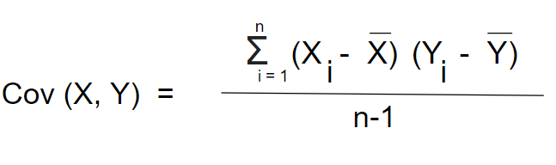
How PCA is performed (cont.)
Find out the covariance matrix
X1
X2
X3
COV(X1X1)
COV(X1X2)
COV(X1X3)
COV(X2X1)
COV(X2X2)
COV(X2X3)
COV(X3X1)
COV(X3X2)
COV(X3X3)

Slide 17
How PCA is performed (cont.)
From the 3X3 Covariance Matrix, calculate 3 eigen values and 3 eigen vectors
COV(X1X1)
COV(X1X2)
COV(X1X3)
Use the methods
You learned in
Level 2
COV(X2X1)
COV(X2X2)
COV(X2X3)
COV(X3X1)
COV(X3X2)
COV(X3X3)

Slide 18
How PCA is performed (cont.)
Now select the largest Eigen values (you may select 2 or 1 here depending on your requirements for this example)
COV(X1X1)
COV(X1X2)
COV(X1X3)
Use the methods
You learned in
Level 2
COV(X2X1)
COV(X2X2)
COV(X2X3)
COV(X3X1)
COV(X3X2)
COV(X3X3)

Slide 19
How PCA is performed (cont.)
Now multiply your entire dataset using the chosen eigen vectors (in this case 2)
X1
X2
X3

Slide 20
How PCA is performed (cont.)
Now multiply your entire dataset using the chosen eigen vectors (in this case 2)

Slide 21
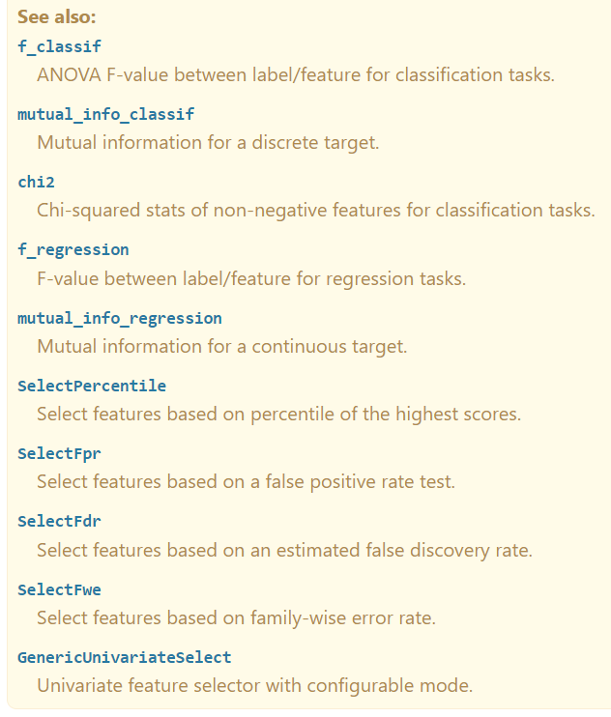
Univariate Selection
Statistical tests can be used to select those features that have the strongest relationship with the output variable.

Slide 22
Filling Up Missing Values

Slide 23
